Slide 1
- Bovine Actinomycosis - Bovine Actinobacillosis
By Dr. Thaer Ali

Slide 2
Actinomycosis (“Lumpy Jaw”)
Actinomycosis is a chronic granulomatous disease of cattle and pigs.
It is caused by Actinomyces bovis which is an obligatory parasite in the mucous membrane of the mouth and pharynx.
Infection occurs following injury with a sharp object or hard feed pieces to the oral mucosa

Slide 3
Postmortem findings:
Lesions in the mandible (Lumpy jaw) or maxilla
Granulomatous lesions in lower part oesophagus or anterior part of the reticulum
Local peritonitis
Mild abomasitis and enteritis

Slide 4
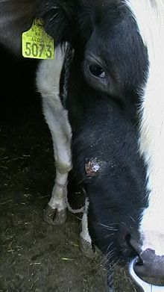
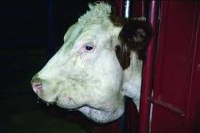
1-bony swelling of the right maxillae 2-bony swelling of the mandible
1
2

Slide 5
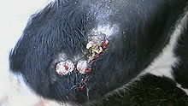
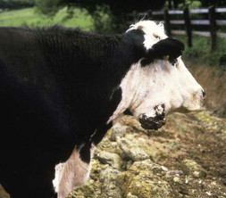
1-thick matter (top) and old fistulous granulomas

Slide 6
Bovine Actinobacillosis
is a specific infectious disease caused by a gram-negative coccibacilli belonging to the genus Actinobacillus. Infection with A. lignieresii is responsible for the wooden tongue disease

Slide 7
Postmortem findings:
Enlarged tongue showing tough fibrous consistency. (“wooden tongue”)
A cluster of small yellowish nodules and erosions of tongue mucosa
Encapsulated abscesses found in lymph nodes.
Marked thickening of the lower part of oesophagus and stomach wall
Raised plaques and erosions in the mucosa of rumen and reticulum

Slide 8
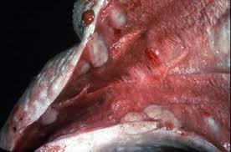
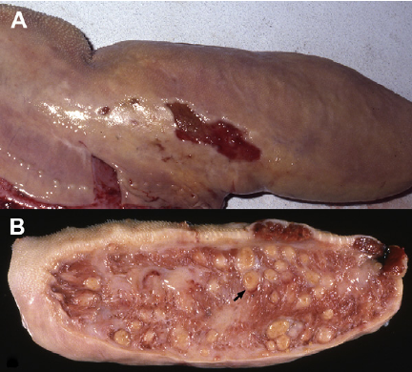
( A ) The tongue is enlarge with several areas of chronic ulceration along its lateral edge ( B ) wooden tongue with numerous pyogranulomas ( arrow ) scattered throughout the tongue.

Slide 9
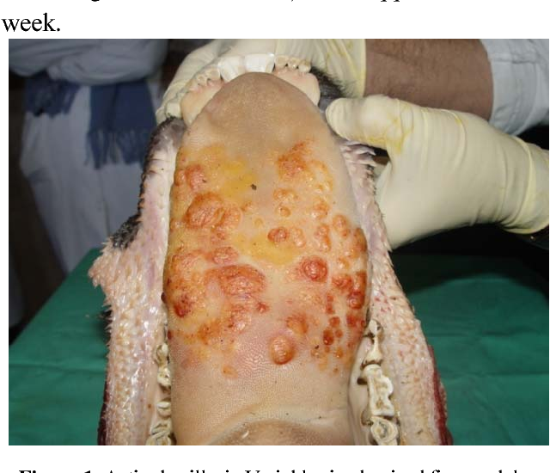
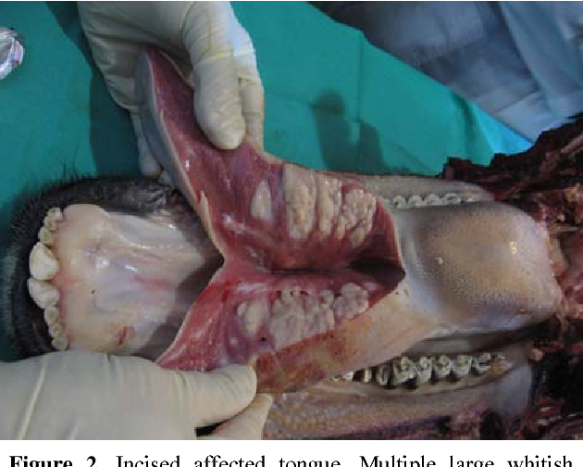
1-affected tongue. Multiple large whitish nodules are seen within the tissue 2- firm nodules and plaques on mid dorsal surface of the tongue
1
2

